Slide 1
Do Do This at Home In Control?
Bob Frankston
https://Frankston.com

Slide 2
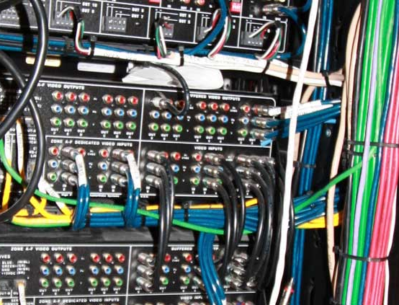
Goals and Constrains
Control, not “automation”
Dynamic vs carefully planned
IP vs wired logic
Learn by Doing
Consumer Electronics
Designed for everyday use
Users as participants
Users as Designers
Not annoy my family
At least, not more then needed
Two-Way signaling

Slide 3
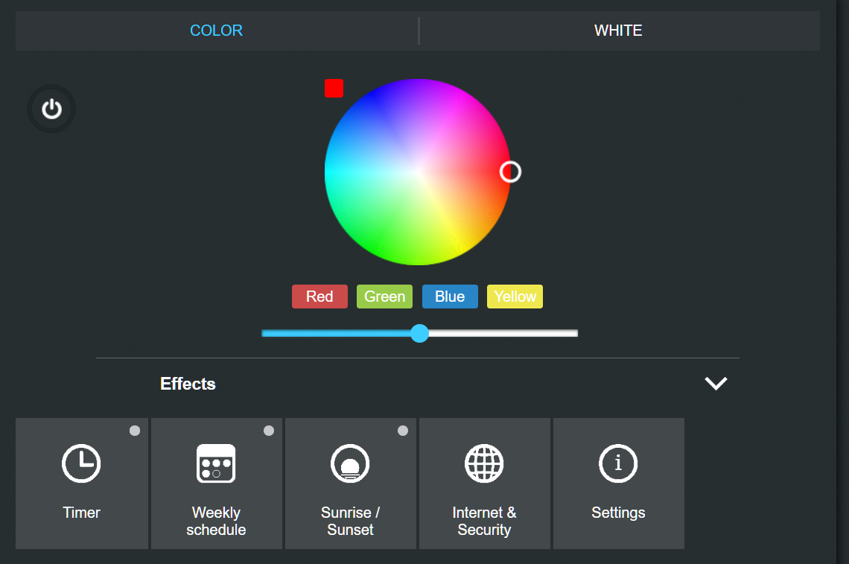
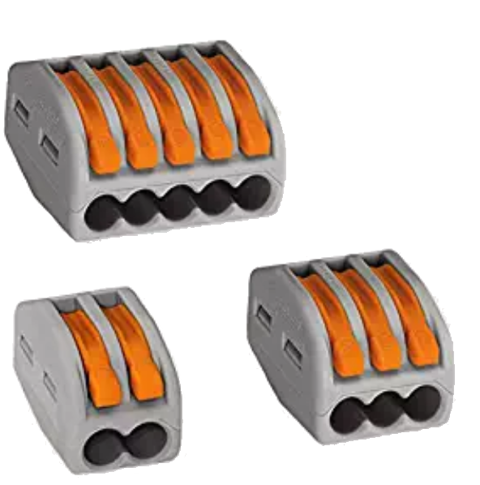
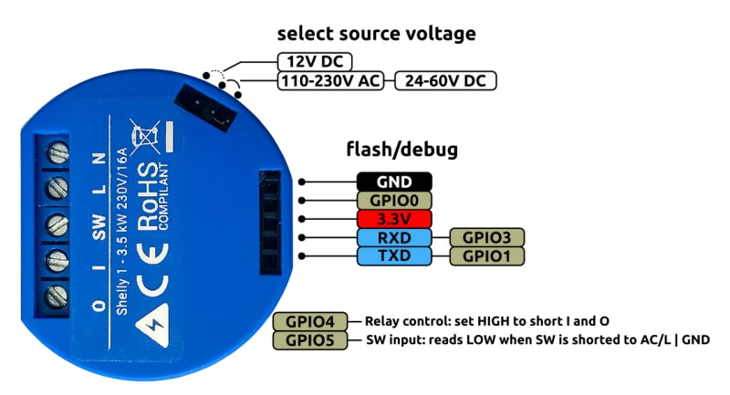
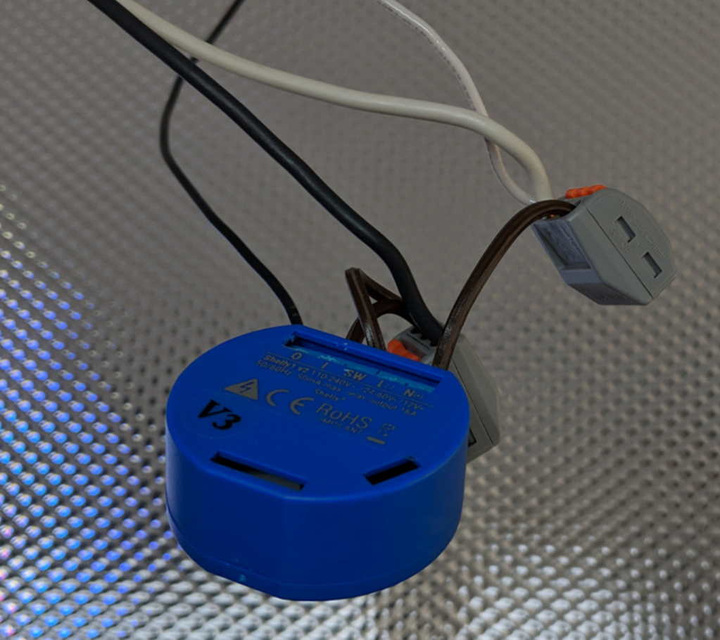
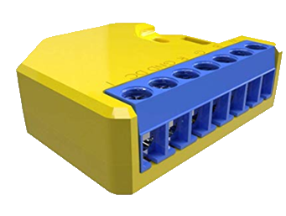
Don’t do This at Home

Slide 4
Preface
The Jetsons is winning ➔ Alexa
It’s not just about light but we learn from 0’s and 1’s

Slide 5
In The Beginning there was X10
At least the beginning of the journey
1970’s – power line signaling
Simply Turn Things on/off
16 Devices, 16 Houses (A-P) => 256 Devices
Keyed on AC 60Hz powerline
One way signaling
Wild cards for all and for lights
Notes:
My DTMF story in Bexley

Slide 6
X10 Evolves
Computer interface (serial port)
Could listen as well as transmit
Additional codes for querying
Smart Home and others improved technology
Motion detection and wireless
Challenges
Unreliable signaling
Slow signaling
Limited Devices

Slide 7
Initial software
Module on PC
Operations queue
Trigger and rules
Rules => Groups!
Serialization
Multithreaded
Use of queues
And database
Also explore programming paradigms

Slide 8
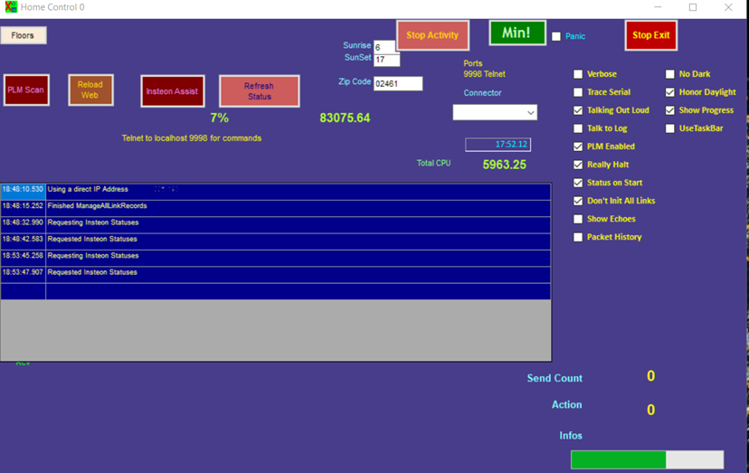
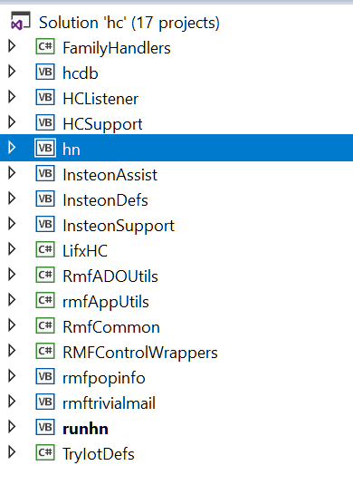

Slide 9
Initial Control Program
Written in Visual Basic 6
Oriented to X-10 challenges and hacks
Database with scripting
Serialized actions and simple rules/triggers
Lessons
Automated scripts have limited utility
Distinguished desired response vs reported state
Trying to tame complexity

Slide 10
Chance to try language features
Dynamic object creation
Dynamic scripting in C# and VB and ..
Rule Engine
Database
Now with LINQ!
Structure values for Action and State/Status
(oops)
Distinguish “intent” vs “state”

Slide 11
Improving X10 / CEBus
Much smarter
A special “turn on” for each device
Automagical configuration
Macro Language
Structure Wiring
Powerline, coax and radio signaling
TDS – Too Damn Smart

Slide 12
Other fancy protocols
Protocols that embed their limits
IEEE-1394 / Firewire
Bluetooth (and now, Bluetooth Mesh)
Zigbee, Z-Wave
Thread? (So close but …)
Limitations
Separate physical facilities and distance limits
Impose policies
Need separate relaying
Presume scarcity

Slide 13
Other Protocol
Lutron
Proprietary
Patented Feedback!
Universal Power Line – UPB
Noble attempt
Still exists but niche

Slide 14
Smart Home Insteon
In the spirit of X10 but better
Higher speed powerline
Fixed end point addresses – 24 bit
Original business model – OEM
Protocol by hardware people
Limited number of hops and echo required
Manual-inspired linking protocol
Buggy initial implementation with very slow work-around
Did a very deep dive and built lots of tools

Slide 15
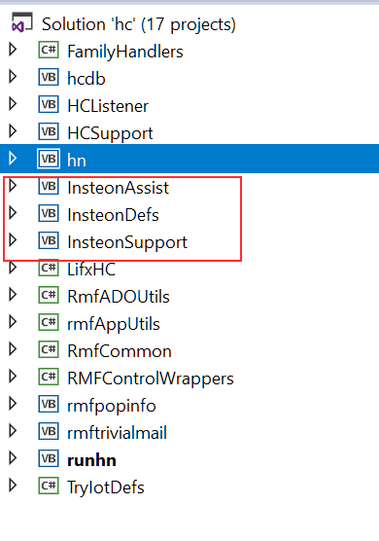
Embracing Insteon
Generalized the program
Additional device type
Lots of complex support
Didn’t realize how dumb protocol is
Had to program around hardware-designed protocols
Deployed devices more widely
Limited scale and devices

Slide 16
SmartThings
Gateway to
Z-Wave
Zigbee etc..
And more
Also
Apps and virtual devices
IFTTT
Alexa etc..

Slide 17
SmartThings
Working around the rule engine
Wrote Groovy to program around
Support own http(s) protocols
Used IOTDB to work around OAuth
Cloud First
Zigbee/Z-Wave
Having to pair (and unpair) devices
Lots of hex codes

Slide 18
Coexisting
My system
Controls On/Off
Controls Brightness
Color etc.. is “To Do”
Coexist wit native apps
Control colors etc..
Option to change only some parameters

Slide 19
FiOS
Upgrading to 150mbps forced me to cleanup Wi-Fi
Speed itself is not that important above threshold
Ubiquiti
Managing access points
Robust coverage
Managing static addresses
FiOS
Uses MOCA
STBs can use IP … but not with my own DHCP Server!

Slide 20
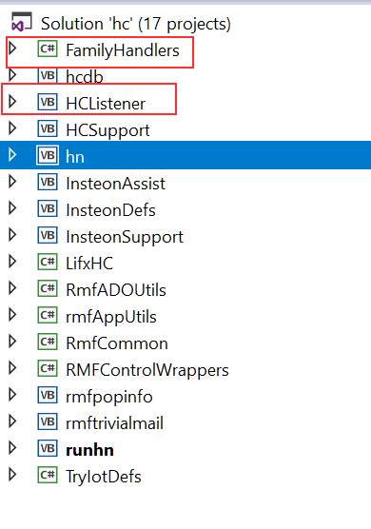
Embracing the Web
Web App V1
TypeScript Visual Studio
Presented floor map w/editing
Turns out buttons are more useful
Event driven
Widgets …
(My) server side
http(s) listener
Act as a nexus for state reporting
Provides floor maps and device info

Slide 21
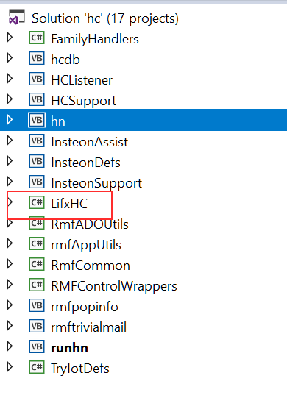
LIFX
IP!!
Bulbs as the end point
Local and Cloud protocols
App
Features
Discovered color temperature and more
Up to 1100 lumens, BR30, IR etc.
But not outdoor
Teething problems
Onboarding issues
DHCP Issues

Slide 22
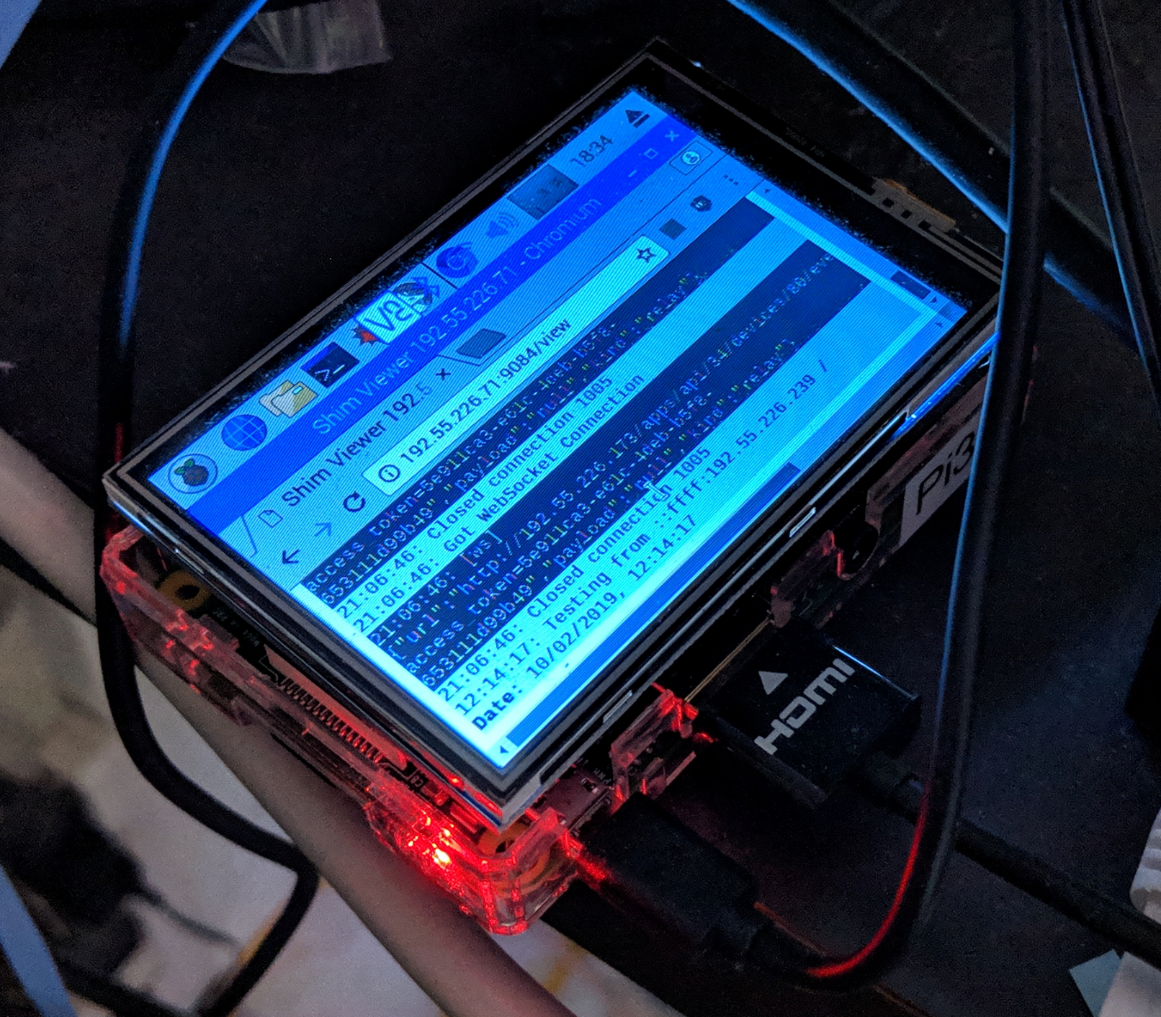
Resilience and NodeJS and npm
Direct control from WebApp!
Removes dependency on main system
CORS ➔ Need shim running on multiple machines (NodeJS)
Still report status to central module
Central module is still an option
Improved programming skills w/Async
IIS dispatch
Was C# /name
Now IISNode

Slide 23
Embracing NodeJS
Scripting ➔ NodeJS
Nightlights
Keep-ons
Visual Studio Code and TypeScript
Plan to shift functions to NodeJS
Mañana
Programming C# vs TypeScript
Flexibility of objects
Vs. Linc

Slide 24
Services
IFTTT – scaling
Alexa
Google Home
Apple Homekit
DIY – HomeAssistant, OpenHab etc.

Slide 25
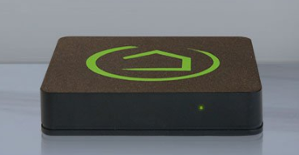
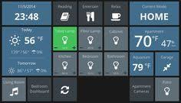
Hubitat
Box vs. DIY Pi
SmartThings emulation
Added “MakerAPI” for me!
Support for Hue, Yeelights, Nanoleaf Etc.
Runs in my house
Shifting my devices (a pain with Z-Wave)

Slide 26
More IP Devices
Discover on Aliexpress and elsewhere
Sonoff – Alexa etc.
But can be reflashed with effort
小米 (米家) / Ewelink
Shelly – simplest API
Also designed for reflashing

Slide 27
Supporting
My own interfaces
Insteon
Lifx (using cloud but have local code in Node)
Shelly
Via Hubitat
Nanoleaf
Yeelights
Hue
Zigbee and Z-Wave
Native apps for full capabilities and on-boarding

Slide 28
IP Support
Using Ubiquity Unifi
Managing naming and finding devices
Static Addresses when necessary
VLAN for guests
Port mapping and Dynamic DNS
Issues
Fall-over isn’t working automatically
Dyn DNS support limited
No API (Exploring using Puppeteer)

Slide 29
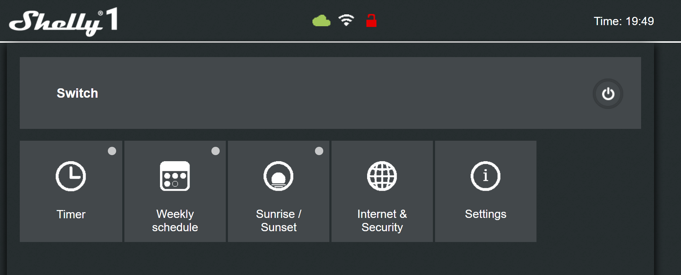
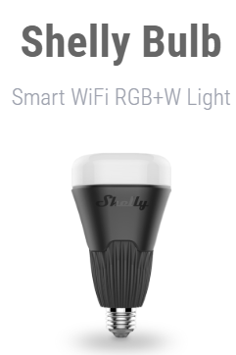

Slide 30
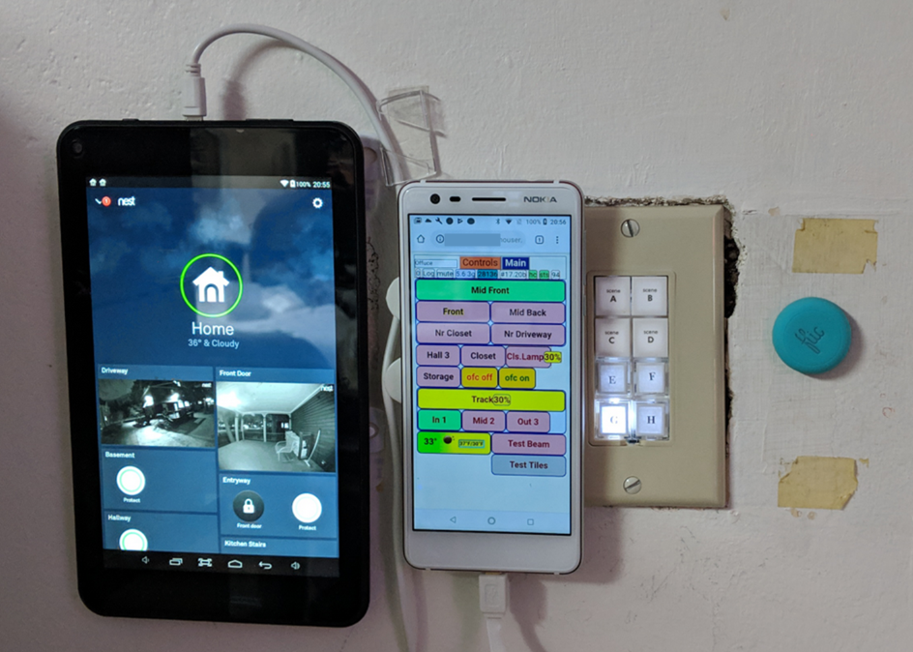

Slide 31
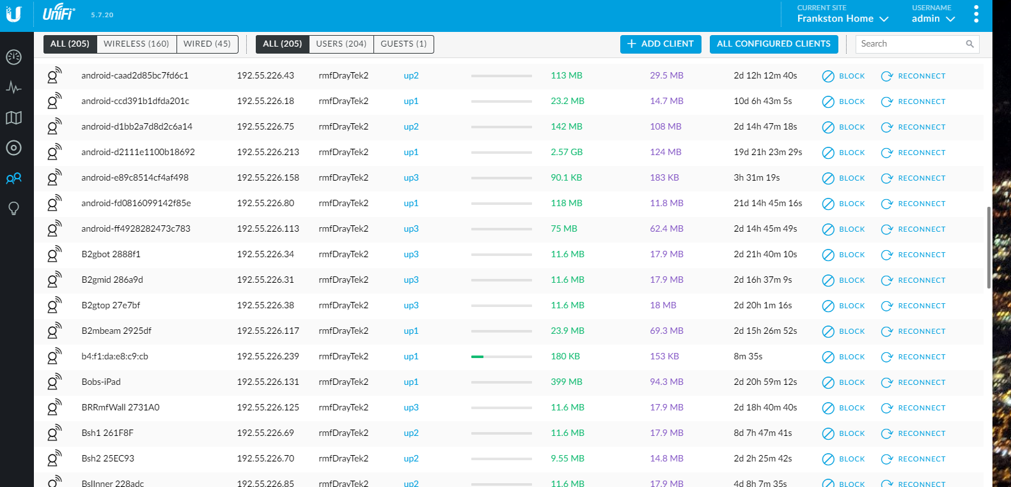
Managing the networking

Slide 32
Lots of lessons and questions
Need a peer internet
Network of networks is the wrong model
Haven’t fully addresses trust/security issues
Inherently ambiguous
Rules (IFTTT etc.) don’t scale and cannot be consistent
Where is knowledge of scenes
How do you I say “I want to read.

Slide 33
Beyond light
Entertainment and ambiance
Music and smart speakers
Video and TV and home theater and the old STB
Doorbells, cameras
HVAC: Nest and thermostats and Rethinking HVAC
Baby monitoring and all that
Stepford Families and smart homes and cities
Computing and Alexa and the Jetsons

Slide 34
Need more APIs
To control more of the home capabilities
But learn by doing
Escaping silos …

Slide 35
Notes
Native vs. normalized
What does on/off do?
Where is a scene known?
Rules vs. Groups
Npm
Nest Y:\photos\ByDate\2018x\201804\20180413\IMG_20180413_121034.jpg

