Slide 1
Infrastructure & Opportunity
Software + Connectivity
This is a draft.
Please send feedback
and suggestions to
InfraTalk202301@bob.ma

Slide 2
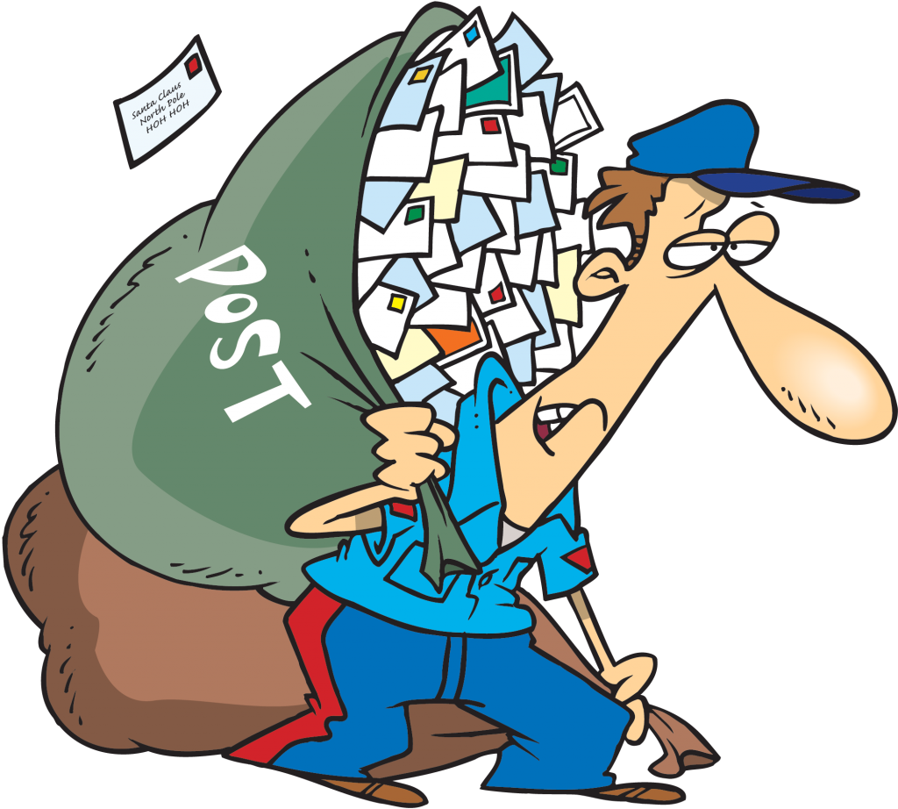
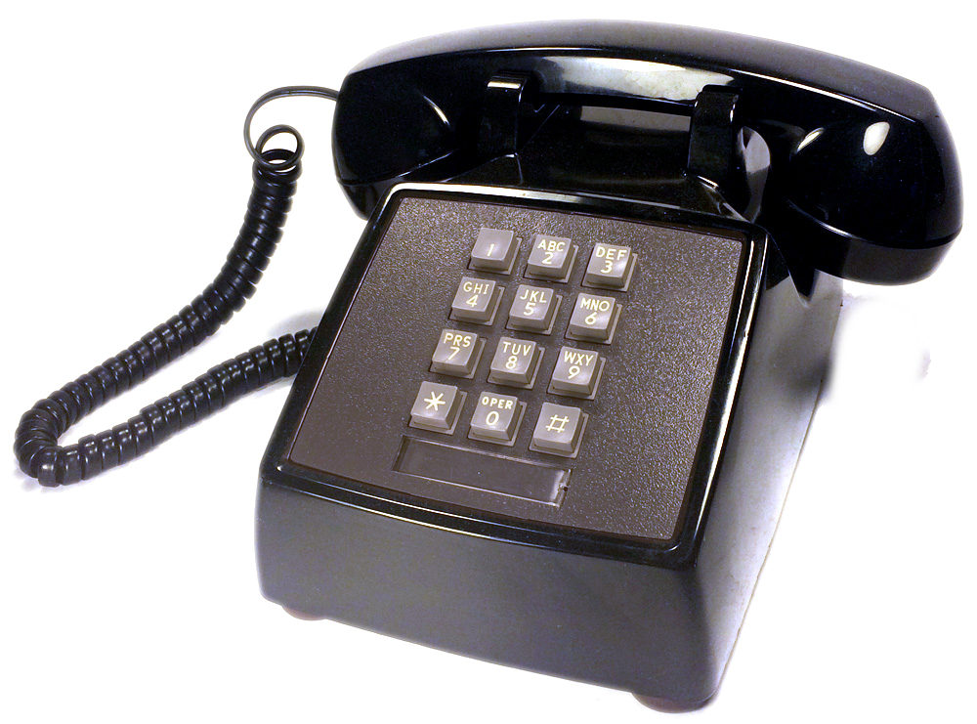
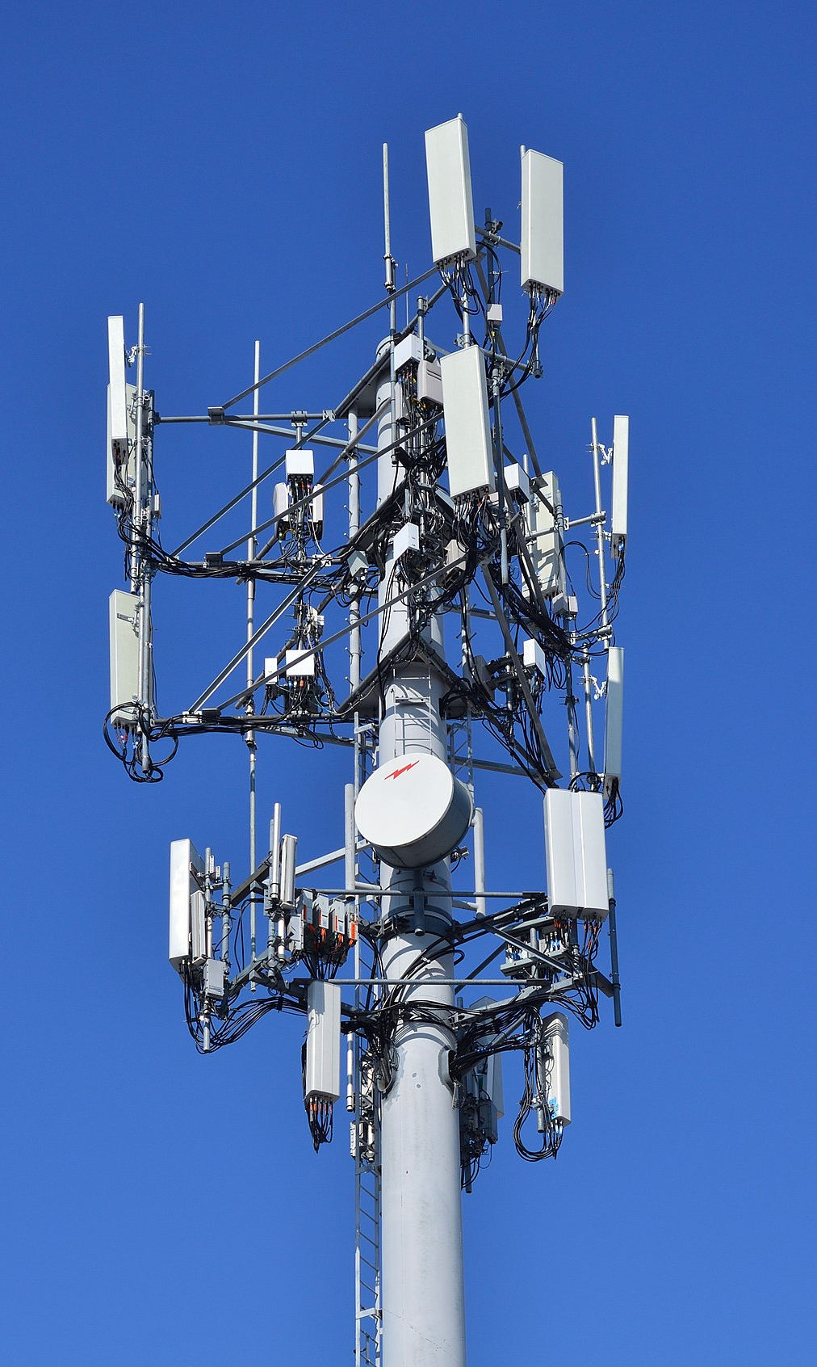
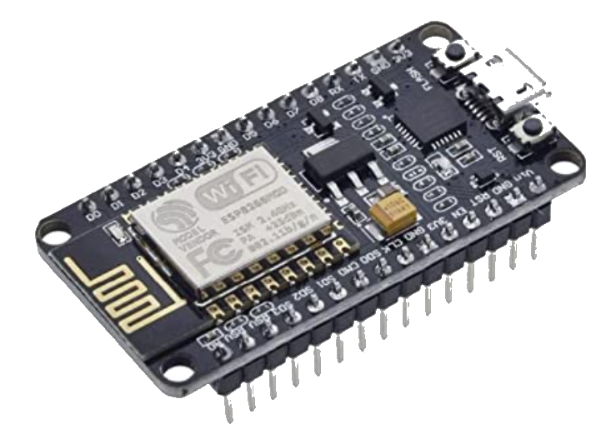
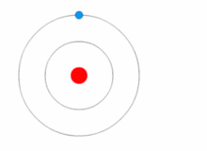
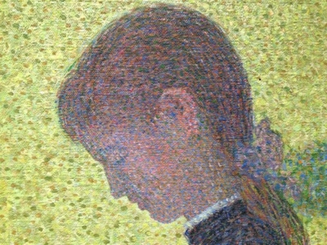
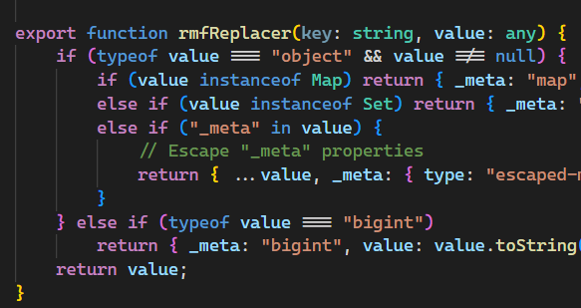
ABCDEFGHIJKLMNOPQRSTUVWXYZ
方思腾
01

Slide 3
The “Agree” screen
Notes:
People accept these sign in or agree screens even when there is free Wi-Fi. I’ve wondered why it bothers me and not others. The simple answer is that I see an Internet that is far more than just the web. I see it as infrastructure I can use for so much more. Just like I did when I was at Microsoft wanting make the devices in my home first class participants in the Internet and not just dialup terminals.

Slide 4
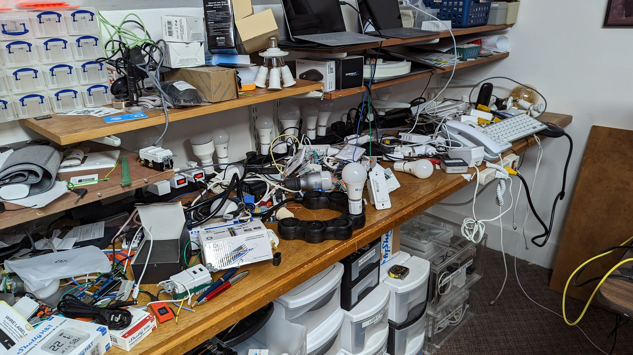
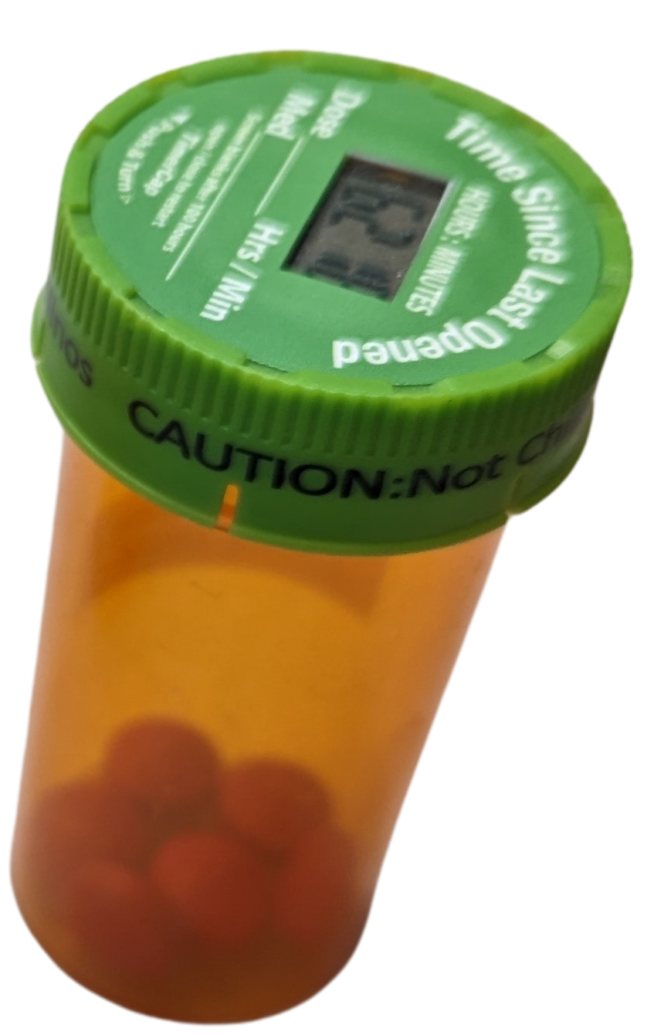
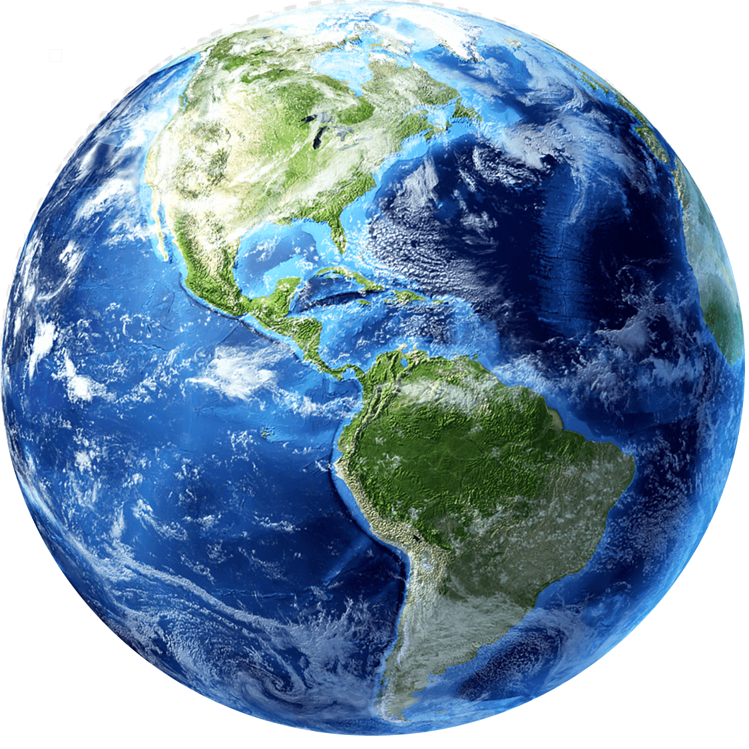
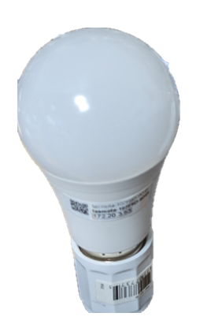
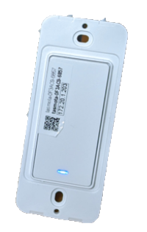
“Connected Anywhere in the World
Notes:
Home networking and individuals – TLB, Tasmota, M

Slide 5
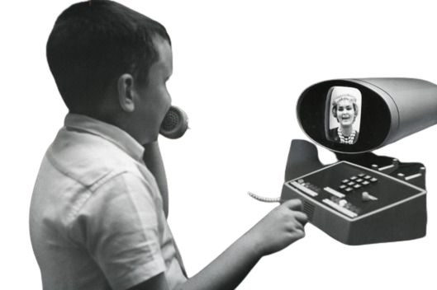
From Telecom ➔ Infrastructure
Hello
#1→Dest1 00101101010100011
Hello
Hello
#3→Dest1 00111101010100011
#5→Dest1 00101101110100011
#2→Dest1 00101101110100011
#4→Dest1 00101101110100011

Slide 6
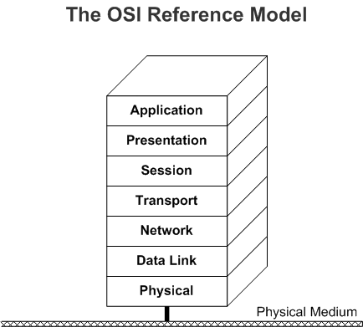
Infrastructure as a Resource
Sharing ➔ Abundance of Capacity
Shared Physical Infrastructure
Networking as a service
Resource
Software – Internet etc.
5G
Resource

Slide 7
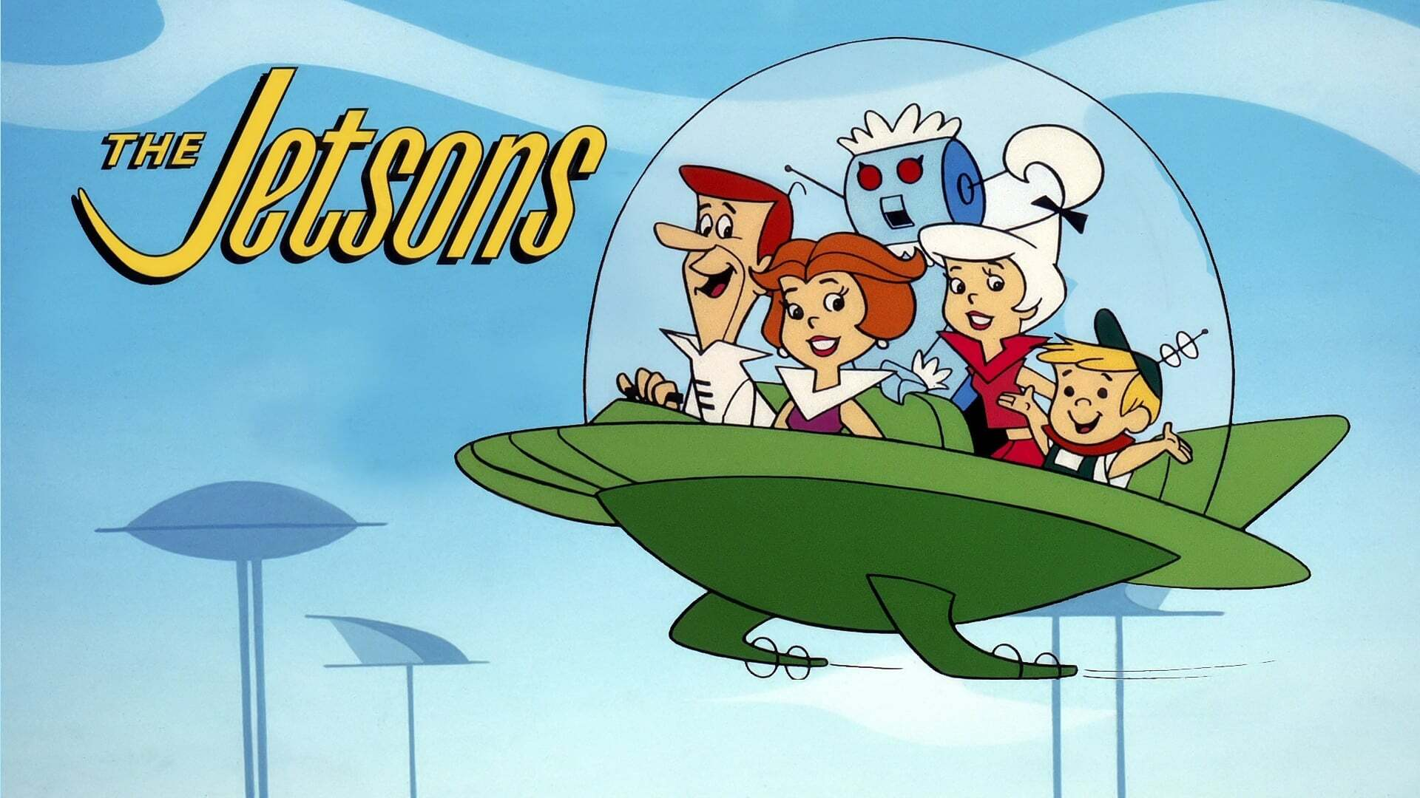
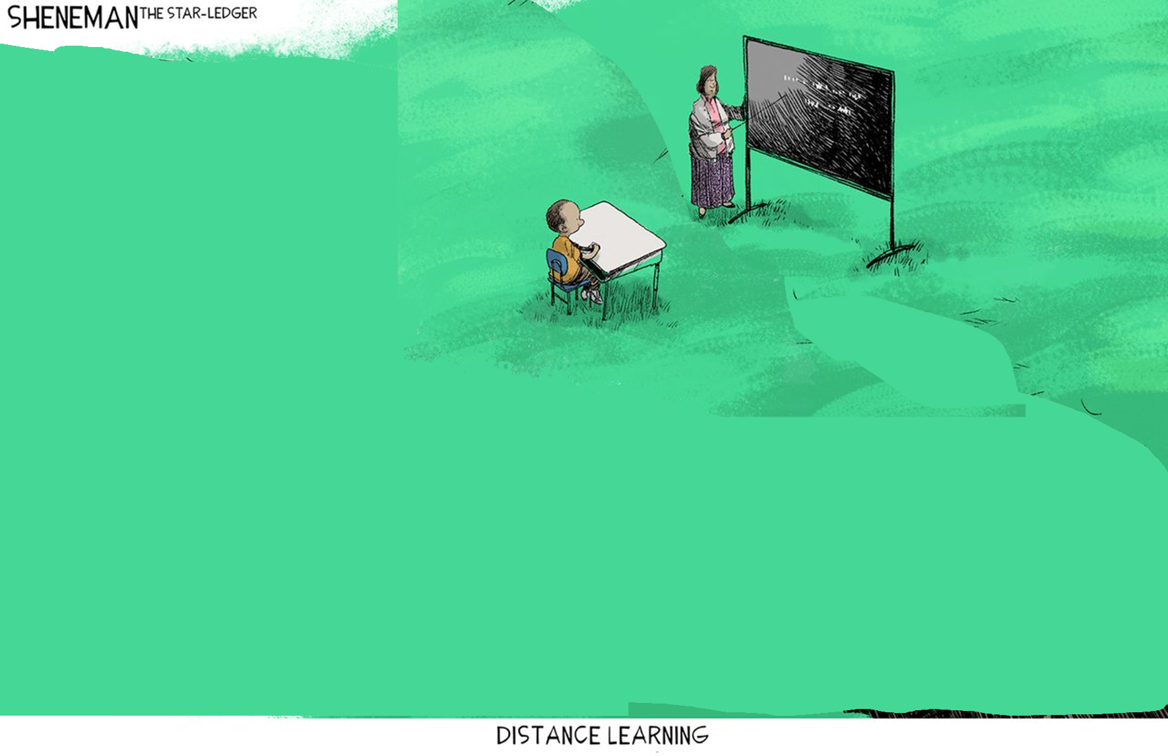
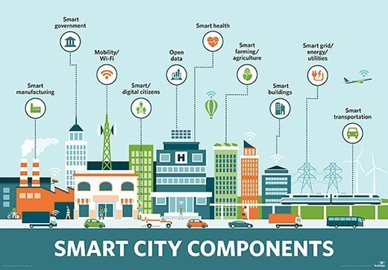
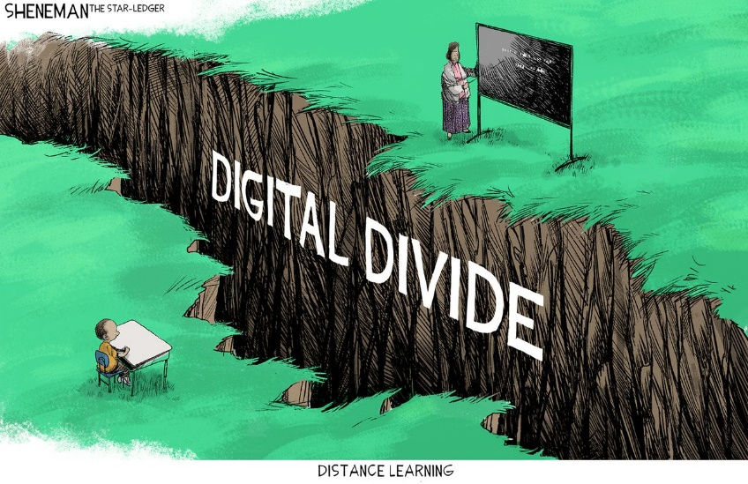
Smart People & Uses
Implemented in Software– Internet etc.
Shared Physical Infrastructure

Slide 8
Services Facilities ➔ Infrastructure
Cost Center
Public Pack Infrastructure
Shared Physical Infrastructure

Slide 9
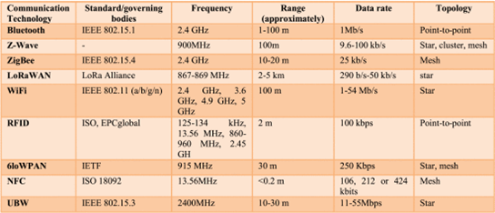
It can be Complicated

Slide 10
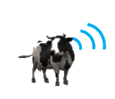
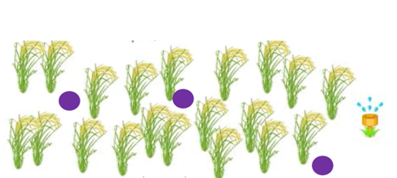
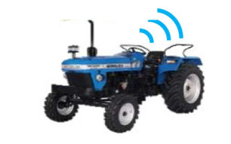
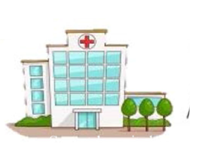
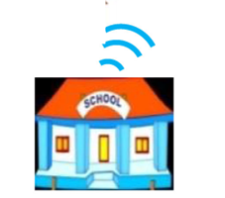
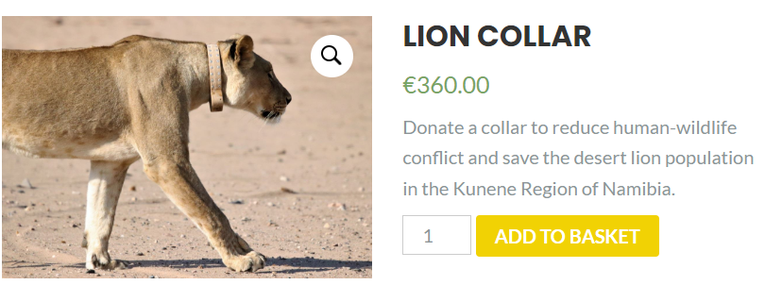
It can be simple: Ambient Connectivity™

Slide 11
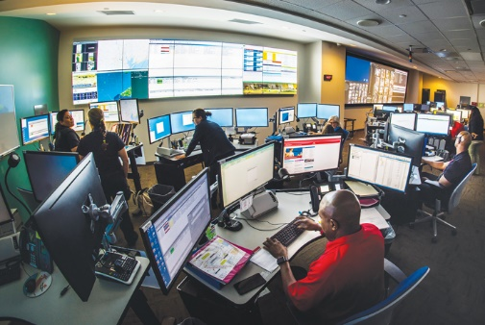
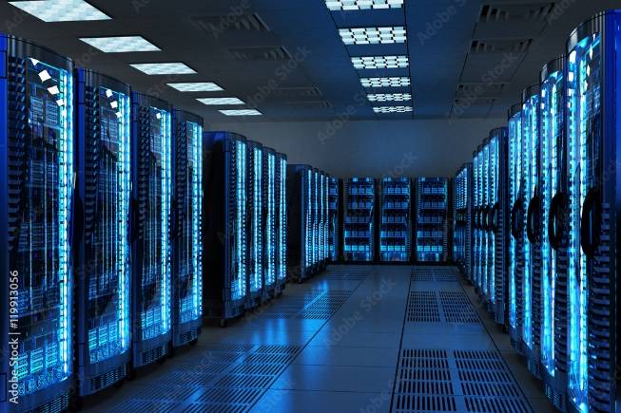
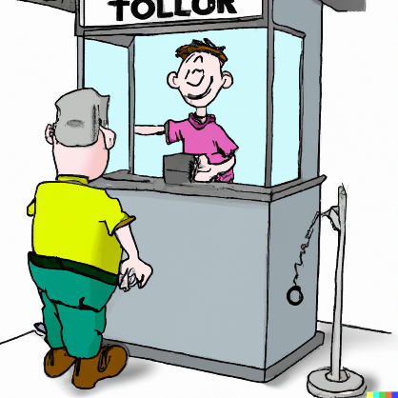
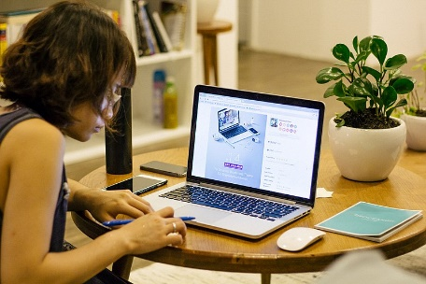
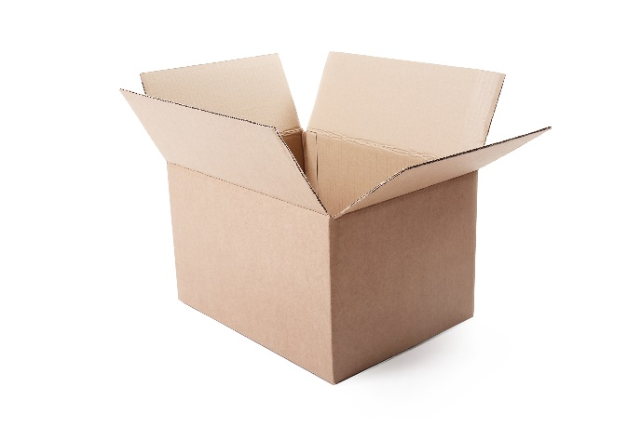
Stakeholders
5G
?
Notes:
Stakeholders aren’t just the people creating the pill bottles, those providing and hosting the applications benefit what happened when we remove the fiction no longer have a toll collector in the path.

Slide 12
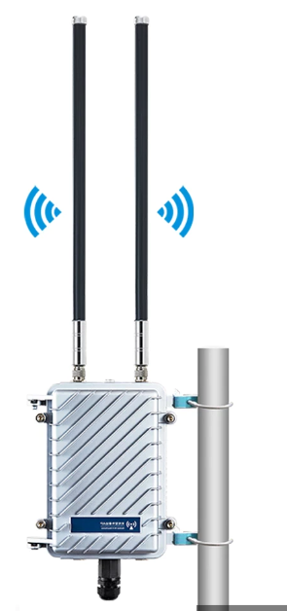
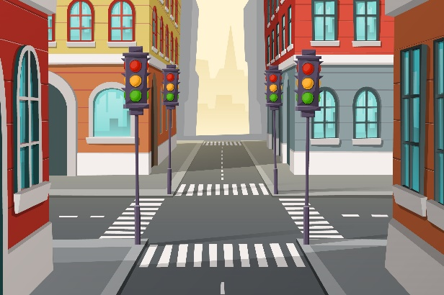
The (non-cost) of Realizing Abundance
Inherent Conflict of Interest
Broadband
Cost ~$50,000/mile
$1000/Year Forever!
Cost >$1,000,000/mile
Free to use
Costs are Rising
Owned by Community
$1000 Mimo!
Free to use
Costs Plummeting
Multiple:
Redundancy, Not competition All profitable??
$40,000
Subscribers
5G/MIMO
If Ownership!
Free to use!
Notes:
"Designed by vectorpocket / Freepik"

Slide 13
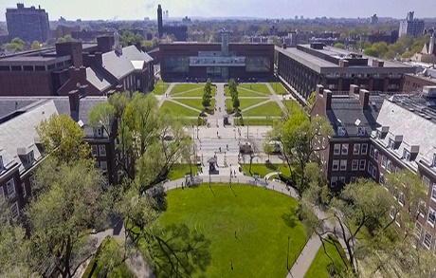
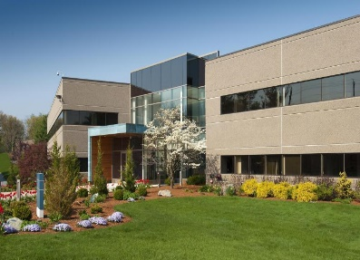
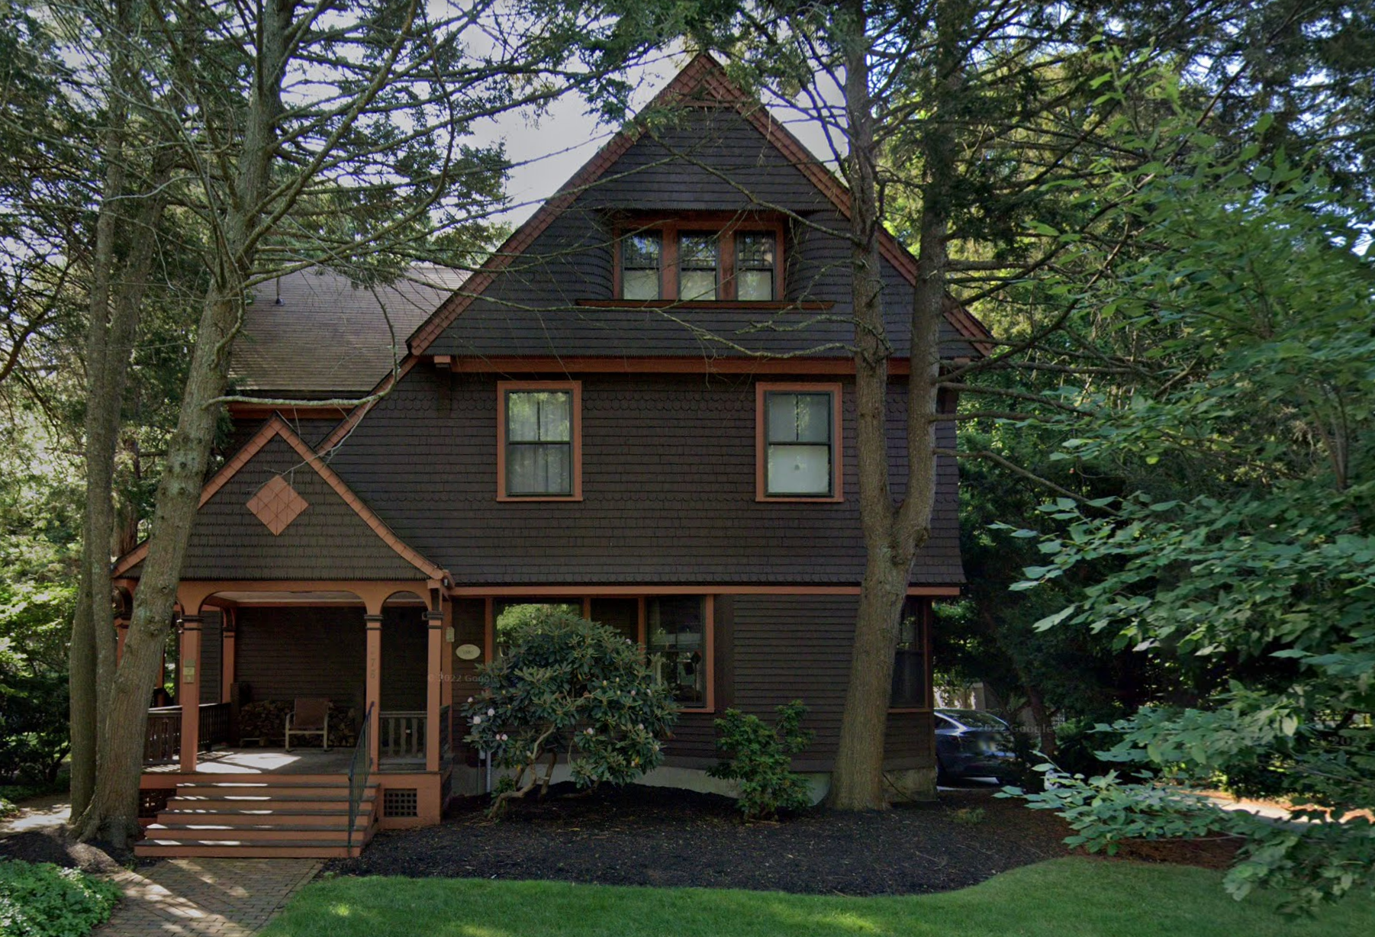
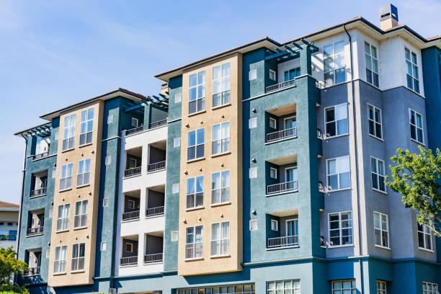
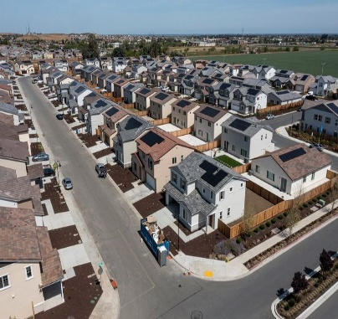
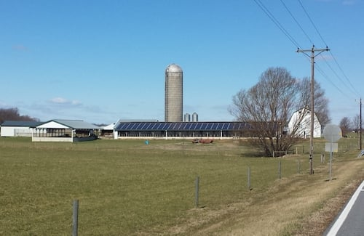
Making it Happen
The key is the geographic footprint
AKA Infrastructure
Residents are the stewards

Slide 14
Further Reading
This is a draft.
Please send feedback
and suggestions to
InfraTalk202301@bob.ma
https://Frankston.com
https://rmf.vc/FurtherReading
AC202212@bob.ma
Terms to think about
The Between vs. Networks
Ambient Connectivity as architecture
Enabling the virtuous cycle

Slide 15
Notes & Scrap Heap Slides Lie Beyond

Slide 16
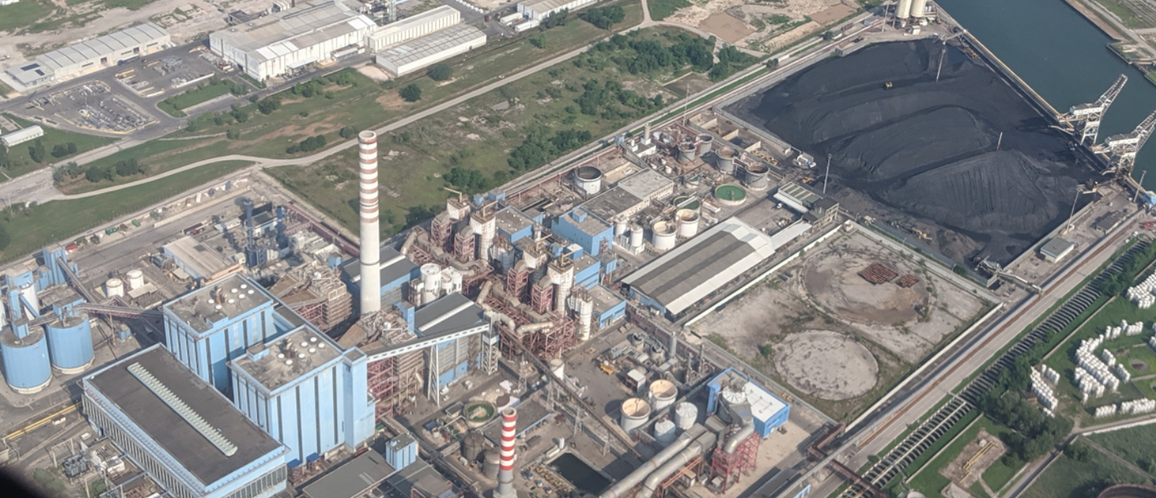
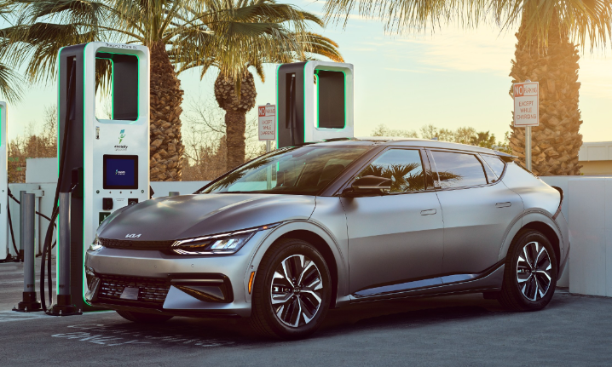
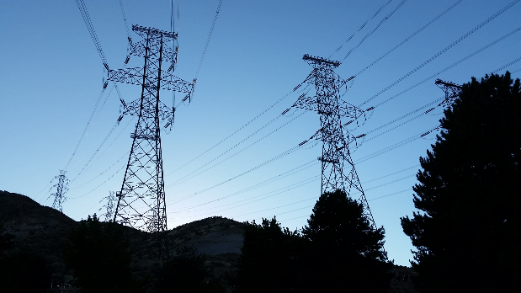
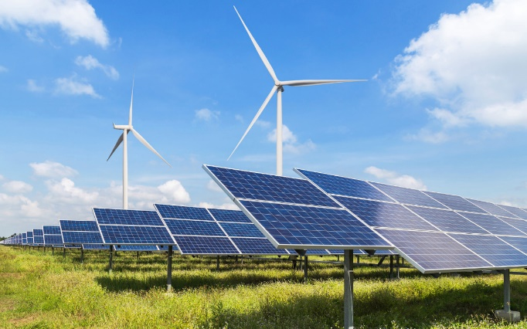
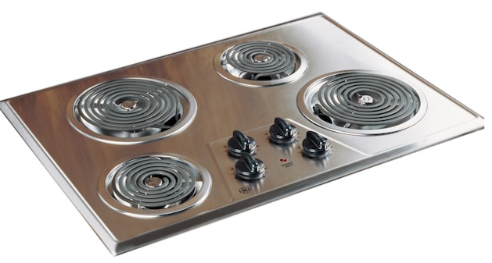
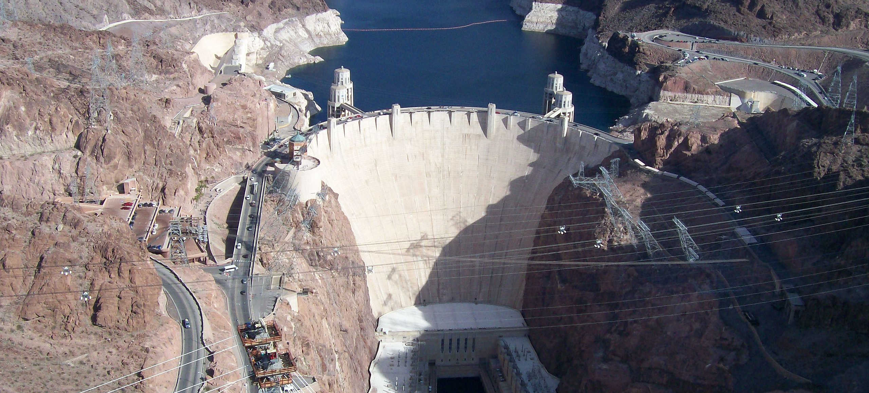
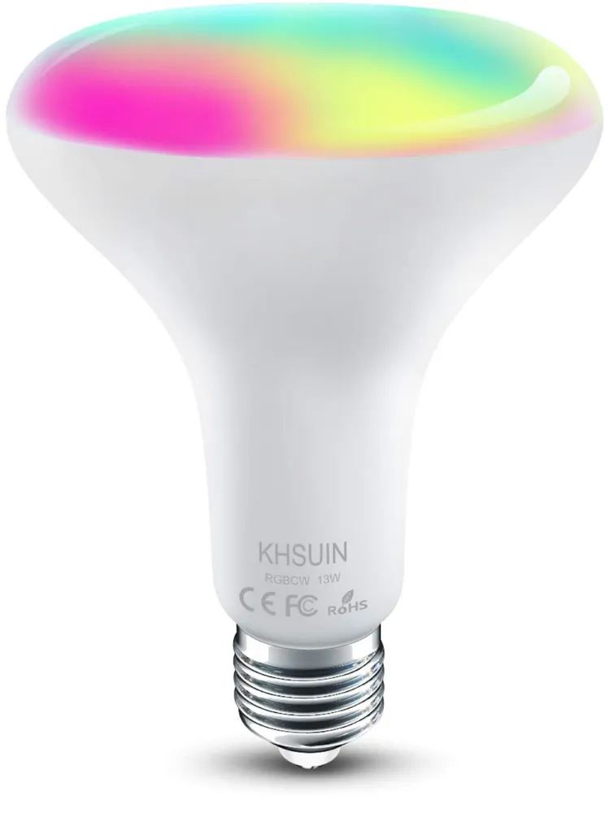
Electrify Everything!

Slide 17
Denying Ourselves Abundance
Inherent Conflict of Interest
Broadband
Cost ~$50,000/mile
$1000/Year Forever!
Cost >$1,000,000/mile
Free to use
Costs are Rising
Owned by Community
$1000 Mimo!
Free to use
Costs Plummeting
Multiple:
Redundancy, Not competition All profitable??
$40,000
Subscribers
5G/MIMO
If Ownership!
Free to use!
Notes:
"Designed by vectorpocket / Freepik"

Slide 18
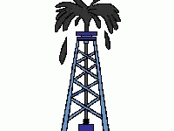
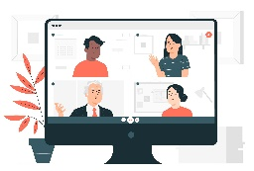
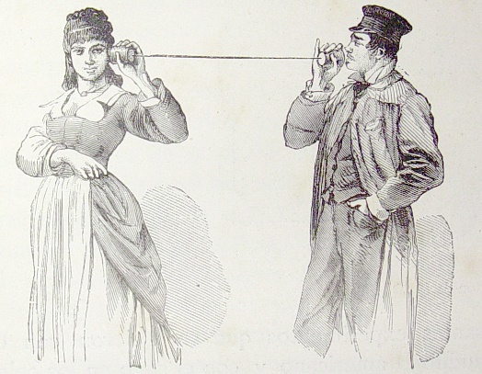
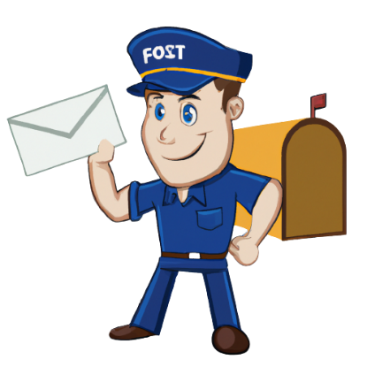
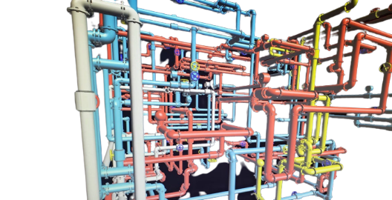
Shifting the Paradigm
Not Facebook
Abundance of What
Surface and behind
Connectivity

Slide 19
Thinking Outside the Pipe

Slide 20
Traditional – a “pipe” potential connection

Slide 21
Enabling the Future Creating Value
Ambient Connectivity Public Packet Infrastructure

Slide 24
One-in-Million – Implement and Share All Needed Resources to Build On & Repeat
And many many others less well known
The Virtuous Cycle

Slide 25
Videos
https://www.pexels.com/

Slide 26
Thinking Outside the Pipe

